Slide 1


SHEDD AQUARIUM
The perfect getaway when you can’t get away.

Slide 2
Competitive and Business Review
Main Business Issues
Chicago is a city that offers a wide variety of attractions and interesting learning experiences.
The Aquarium competes with other great attractions* and should position itself as a must-see and favorite choice for local families, our main target.
Ticket prices. Despite offering unique experiences and the fact that the money is used for conservation initiatives and animal care, there is a general perception that it’s expensive and users hesitate when making a purchase.
The process of entering the aquarium makes the experience not entirely positive which can represent a key liability in the leadership of the category.
*Category: Shedd Aquarium, Field Museum, Chicago Children’s Museum, and the Art Institute.

Slide 3
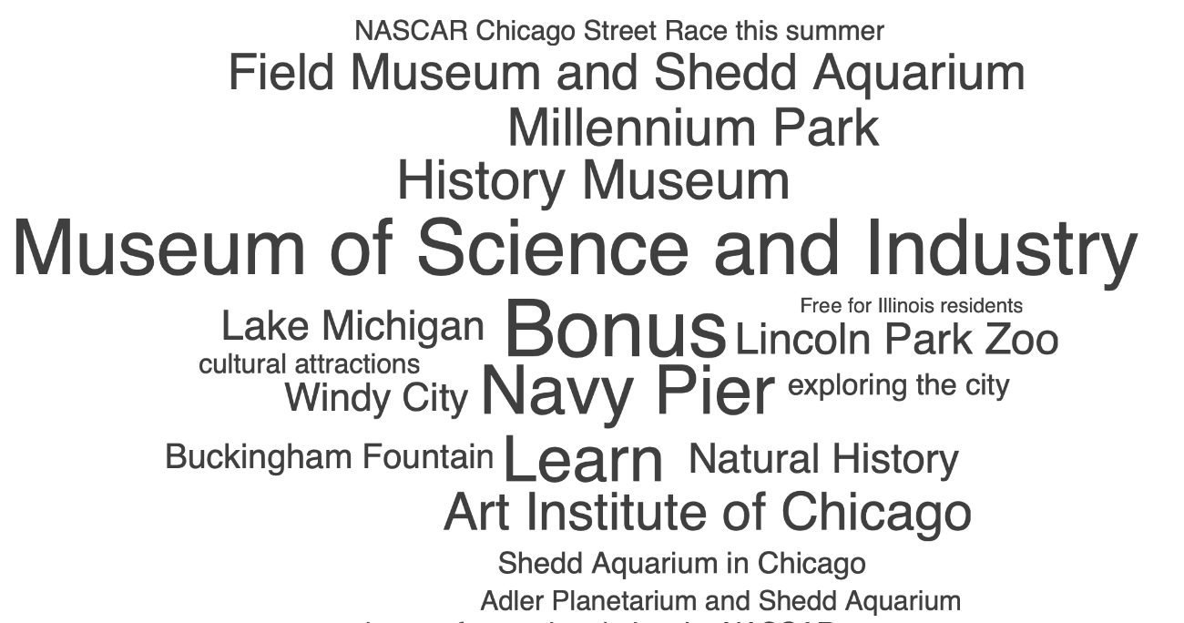
Competitive and Business Review
Category Review:
The Shedd Aquarium holds a strong position as one of the most prominent and visited museums in the city.
Top competitors in Chicago: Chicago Children’s Museum, Field Museum, and Art Institute.
Source: Brandwatch. 2023

Slide 4







Competitive and Business Review
Category Positioning
316 K
7.3 K
147 K
718 K
513 K
26 K
251 K
576 K
23.5 K
855
7.2K
38.3K
149 K
5K
107K
373K
Notes:
Shedd - Aprox 2 Million visitors per year
Children’s Museum - 400,00 visitors per year
Field Museum - >600,000 visitors per year
Art Institute - >1.5 Million visitors per year

Slide 5
Competitive and Business Review
Category Positioning
2 Million visitors annually.
400,000 visitors annually.
> 600,000 visitors annually.
> 1.5 Million visitors annually.
Revenue in 2022: 55.1 Million
Revenue in 2022: 6.8 Million
Revenue in 2022: 90 Million
Revenue in 2022: 51.0 Million
Notes:
Shedd - Aprox 2 Million visitors per year
Children’s Museum - 400,00 visitors per year
Field Museum - >600,000 visitors per year
Art Institute - >1.5 Million visitors per year
Shedd Rev 2022: 55.1M
Art 51.0 M
Field 90M
Childrens 6.8M

Slide 6
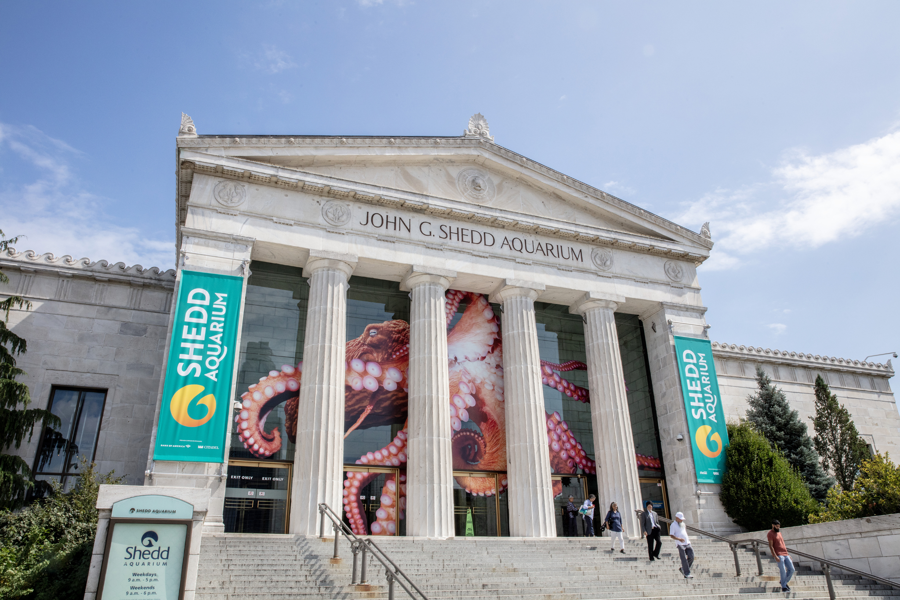
Competitive and Business Review
Category Positioning
Shedd Aquarium
Known for its extensive collection of aquatic species.
Leading institution for marine research, conservation, and education.
Notes:
Shedd home to more than 1500 species and 32,000 animals

Slide 7
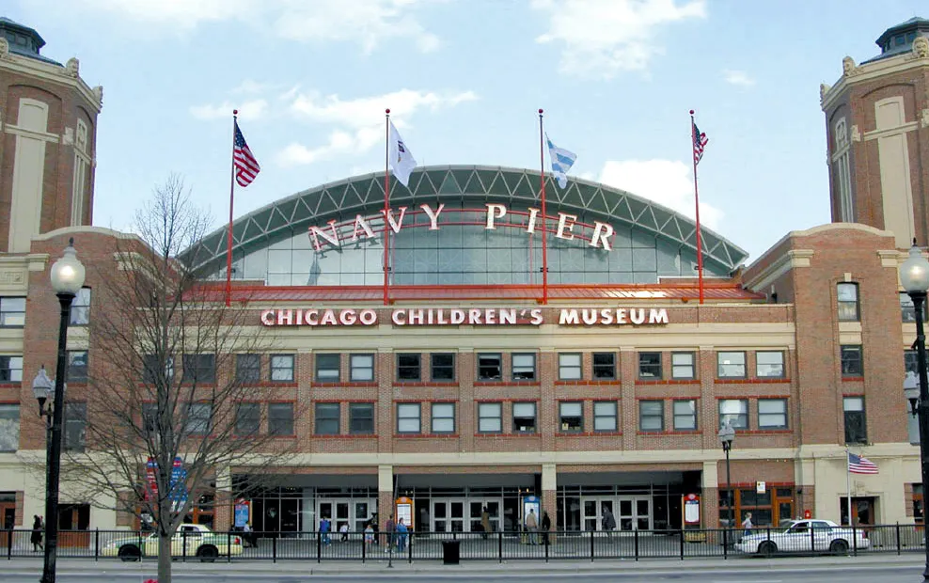
Competitive and Business Review
Category Positioning
Chicago Children's Museum
Interactive exhibits and activities that promote learning and playfulness.
Stimulating and educational experiences where children can explore different topics and concepts.

Slide 8
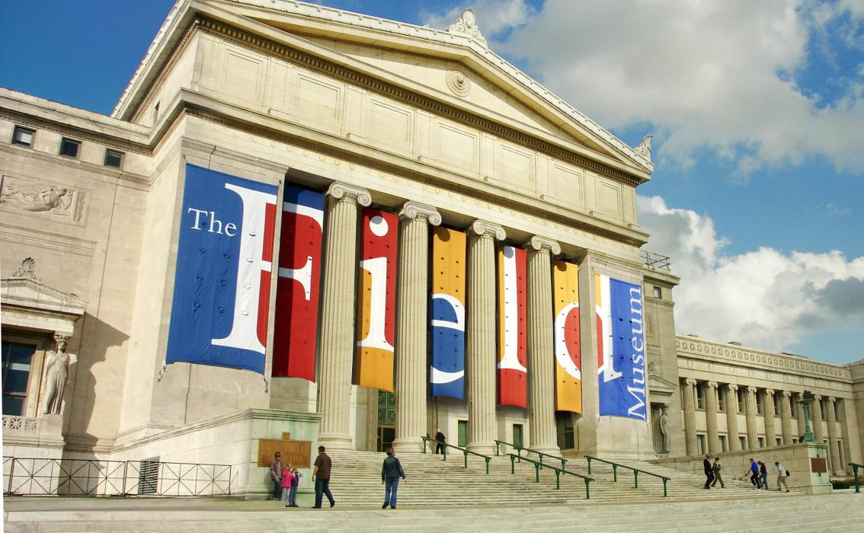
Competitive and Business Review
Category Positioning
Field Museum
Aims to engage visitors of all ages and inspire curiosity and understanding of the world's biodiversity, ancient civilizations, and ecosystems.

Slide 9
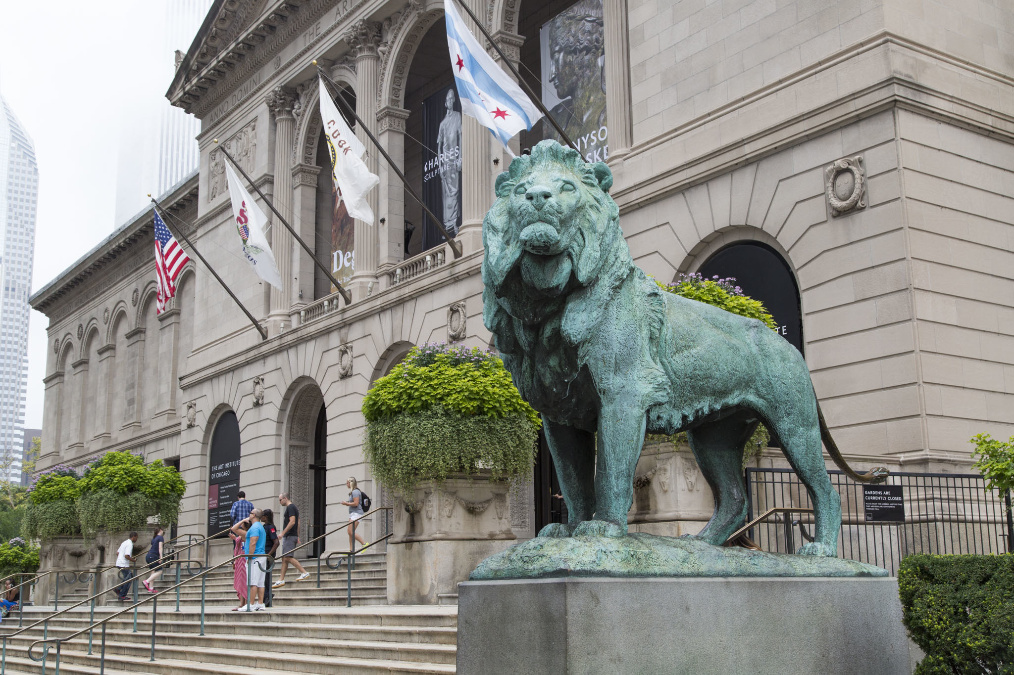
Competitive and Business Review
Category Positioning
Art Institute of Chicago
With an extensive collection showcasing various art movements, and styles, it offers diverse exhibitions, educational programs, and events that celebrate artistic expression.

Slide 10
Insights
Shedd competes with many Chicago institutions
Increasing social media presence can attract visitors
Target audience: families with young children
  looking for an activity that allows them to do something new
  fun activity when leaving the city isn’t an option
  good way to spend a day with family
Notes:
a day to spend with family
get them out of their daily routine
fun activity

Slide 11
Strategy for Shedd
Visitors have positive perceptions of these museums, considering them as valuable and engaging educational resources, cultural institutions, and sources of entertainment for different age groups and interests.
Main differentiators:
By focusing on these points of differentiation, Shedd Aquarium can solidify its position as a unique and compelling destination that offers unique experiences centered around aquatic life, conservation, education, and innovation.
Unique Aquatic Focus
Family Oriented
Education and Interactive Programs

Slide 12
Strategy for Shedd
STRENGTHS
Diverse and extensive exhibits
  over 32,000 aquatic animals
  more than 1,500 species
Variety of programs for adults and children
8 year-round interactive exhibits
  summer: stingray touch
Strong reputation for conservation efforts
WEAKNESSES
Social media presence and online customer service is lacking
Confusion and lack of communication regarding buying tickets and entrance
Inconsistent ticket pricing
Animal captivity:
PETA spoke out about Shedd’s treatment of beluga whales (2016)

Slide 13
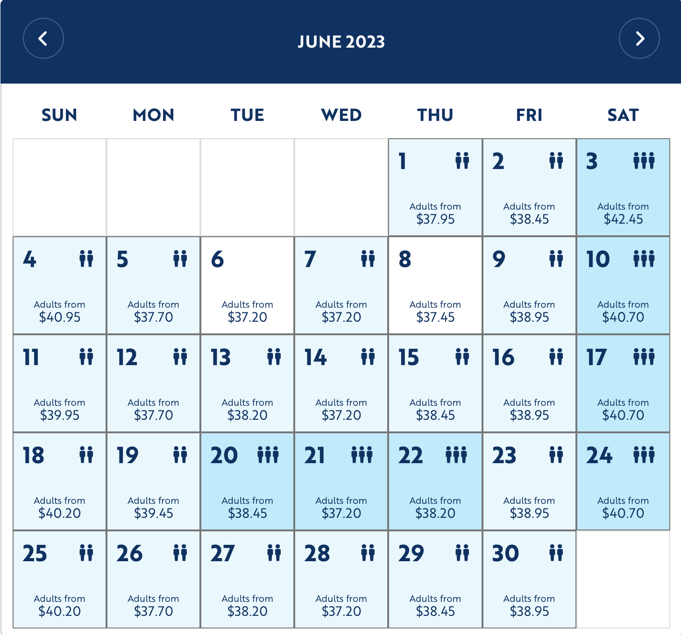
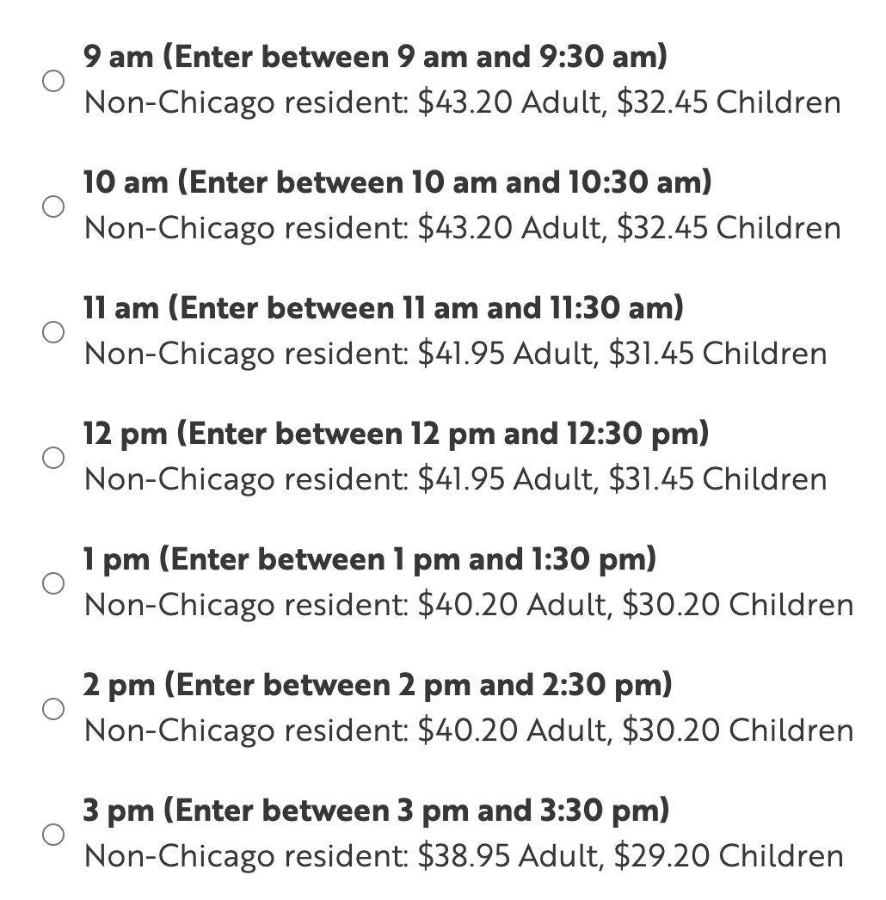
Wednesday May 31, 2023
Notes:
be more clear & concise: if you enter after 1pm, it’s half-priced admission rather than the slow, gradual change in ticket pricing

Slide 14
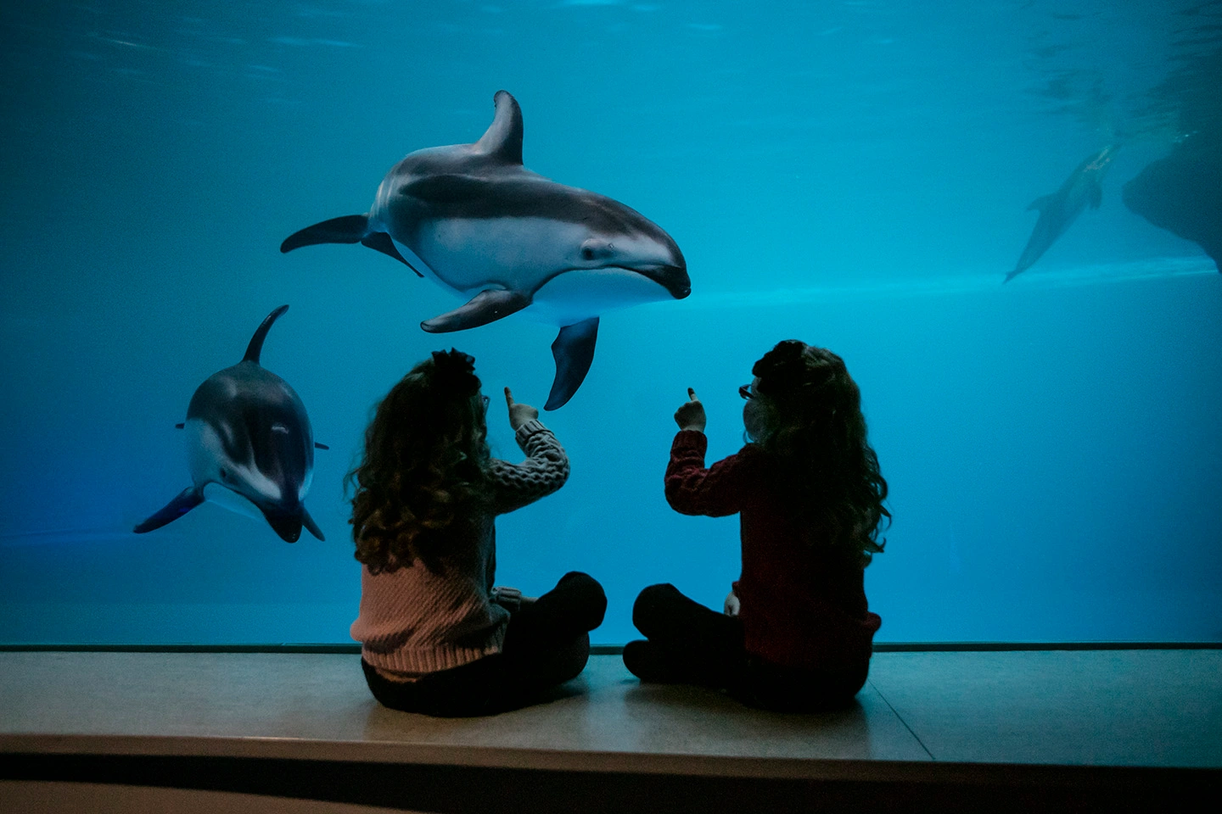
Target Audience
Families with young children in the Chicagoland area
Characteristics
Demographics:
Families living in the Chicago area. Likely to be in their 30s to 40s and may have one or more children ranging from toddlers to teenagers. They come from diverse backgrounds and may represent various ethnicities, cultures, and socioeconomic statuses.
Family-oriented:
The audience prioritizes family activities and seeks opportunities for quality time and bonding experiences with their children. They are interested in engaging their kids in educational and recreational activities that cater to different age groups.

Slide 15
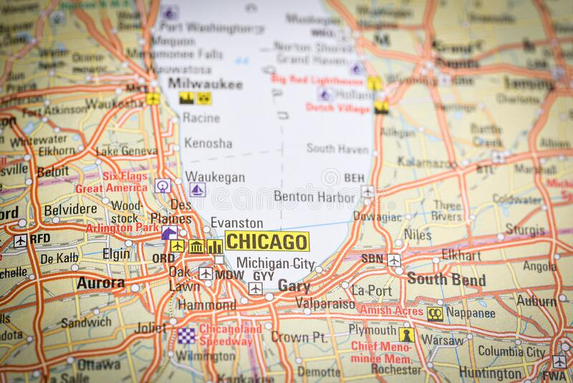
Target Audience
Families with young children in the Chicagoland area
Characteristics
Proximity:
Being residents of Chicago, they have easy access to local attractions and are more likely to be repeat visitors. Interested in experiences that are close to home and convenient for day or weekend trips.
Value for Money:
The audience seeks experiences that offer value for their money. They are likely to consider factors such as admission prices, discounts, special offers, and good customer service when choosing family activities.

Slide 16
Strategy Statement (CTB)
Convince Families with young children, in the Chicagoland area, that Shedd is the perfect getaway when they can’t get away because it immerses guests in habitats from all over the world.

Slide 17
Creative Tagline
Shedd, the perfect getaway when you can’t get away.

Slide 18
Media Recommendations
Objectives
• Awareness:
Increase and generate awareness amongst families with young children in the Chicagoland area about Shedd Aquarium as the perfect getaway option.
• Engagement:
Encourage families to visit Shedd Aquarium by creating an emotional connection and highlighting the immersive experiences.
• Frequency:
With a high frequency of advertising across multiple channels, reach families in their 30s - 40s with 1 or 2 children in Chicagoland.

Slide 19
Media Recommendations
Selection of Media
TV: Effective to reach mass audiences and target specific viewing groups.
Allows for visual storytelling, showcasing the immersive experiences at Shedd Aquarium and evoking the desire for a family getaway.
Digital Platforms: Social media (IG, YT, TT, FB) + website.
An opportunity to engage with families directly, offering interactive content that can be shared, commented on, and liked, amplifying the campaign's reach.

Slide 20
Media Recommendations
Selection of Media Types
Outdoor Advertising: constant reminders to families about Shedd Aquarium, creating brand recognition and generating curiosity.
Placed on high-traffic areas.
Spotify: Sponsorship and ads on kids playlists and podcasts.

Slide 21
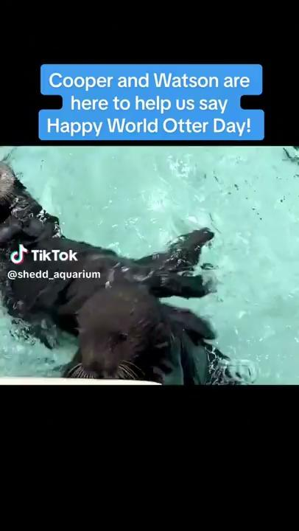
Owned Media: TikTok
Videos featuring children who visit Shedd
Videos of special events hosted at Shedd
Shedd’s weekly videos sharing a fact related to the Aquarium
Algorithm would place these videos on the
feeds of parents in the Chicagoland area with young children.
Notes:
Lauren
TikTok videos: children giving testimonials, and answering trivia questions for small prizes.
Screenshot for this page from Shedd’s TikTok
Shedd will host events for families at Shedd.
Shedd sharing weekly fact videos, either of a fact about Shedd, or an animal who lives there, or their conservation efforts.
FRIDAY MORNINGS: GETTING PEOPLE TO COME IN OVER THE WEEKEND WHEN TICKET PRICES ARE HIGHER

Slide 22
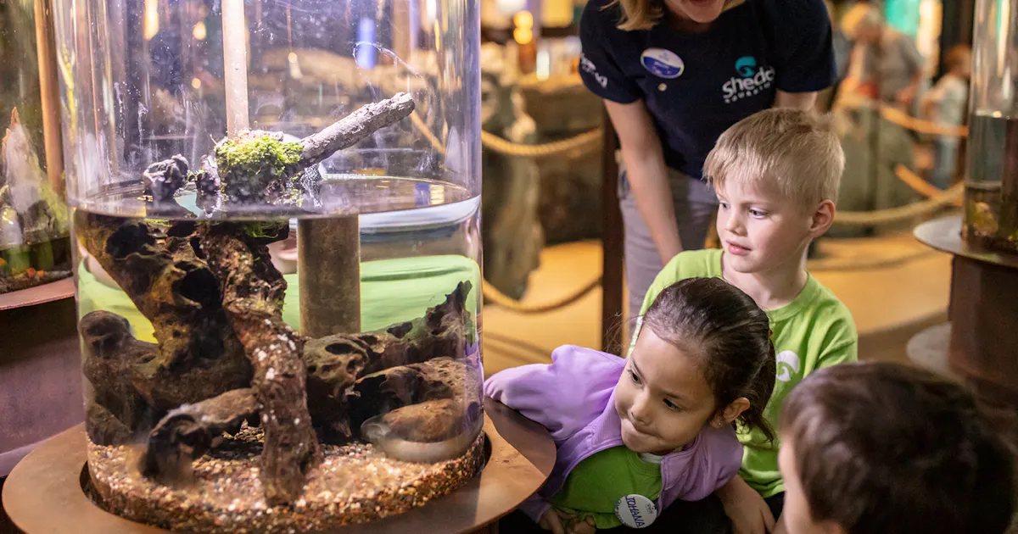
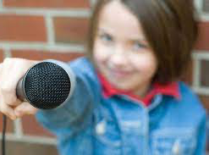
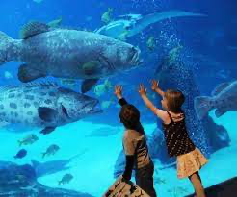
Instagram
Videos featuring children who visit Shedd (with parental consent)
Videos of special events hosted at Shedd
Shedd’s weekly videos sharing a fact related to the Aquarium.
Stories and highlights feature
Notes:
Lauren

Slide 23
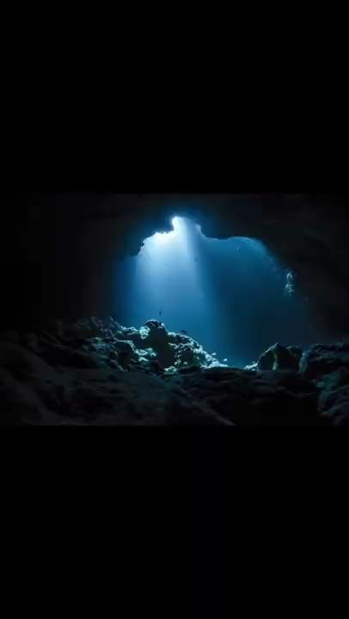
TV-Spot
Thursday nights 6pm-7pm
Saturday mornings 7am-10am
see script on next slide
Notes:
Lauren

Slide 24
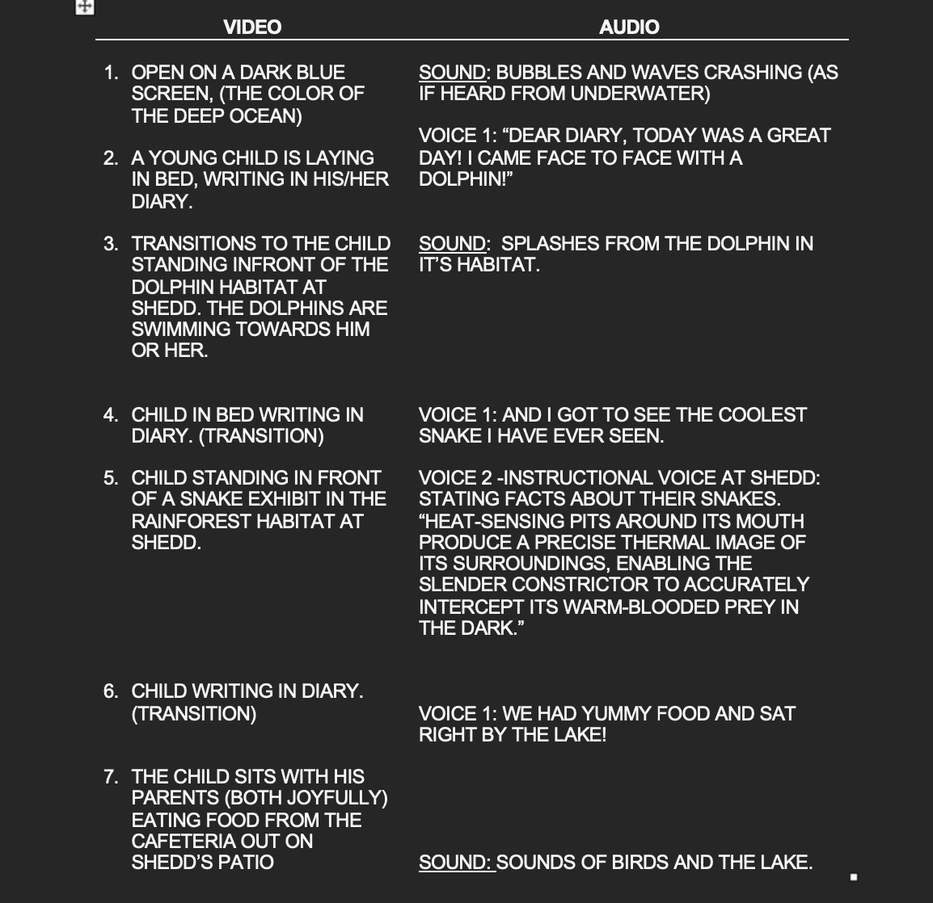
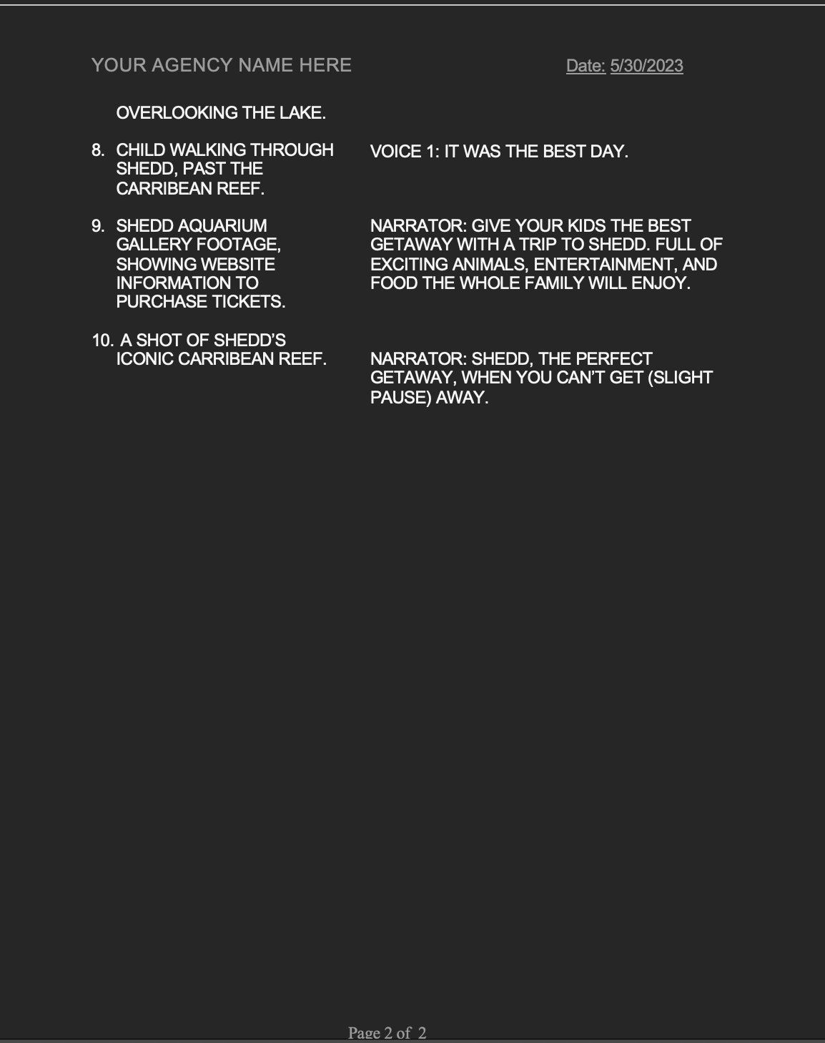
Notes:
Lauren
Add script - Screenshots

Slide 25
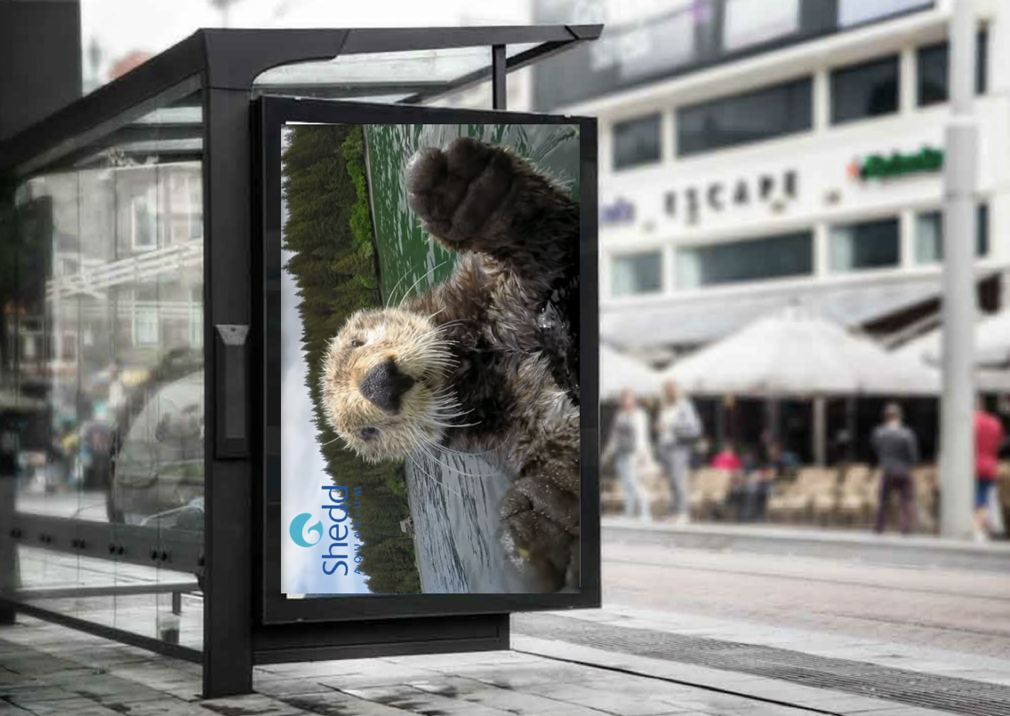
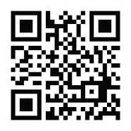
OOH: Interactive outdoor media
Supermarkets and stores
Parks
Transit stations
Local attractions
Lake front
Eye tracking model
Notes:
Lauren

Slide 26
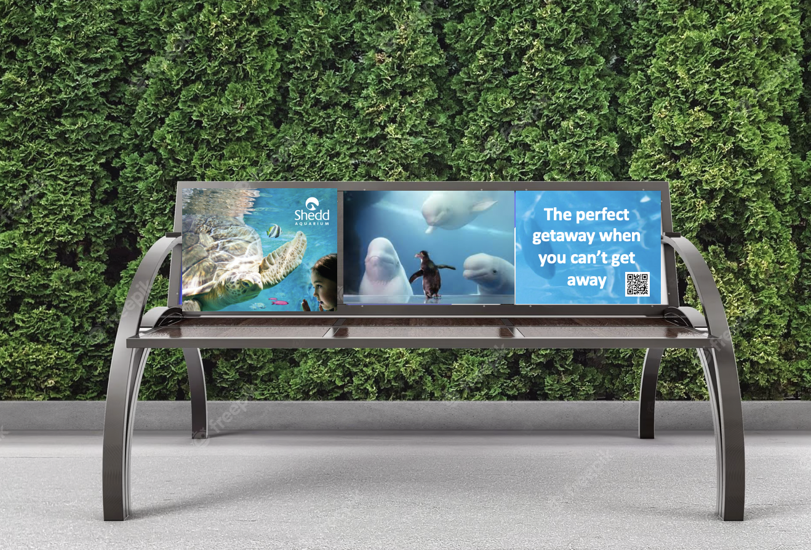
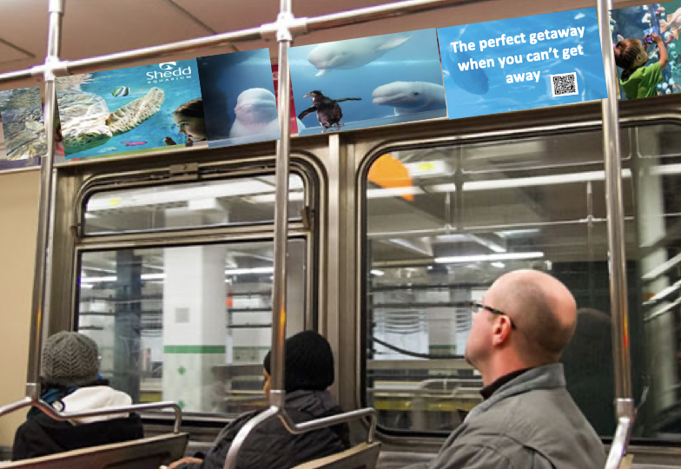
OOH: Street furniture
Parks
In-train car banners
Notes:
Lauren

Slide 27
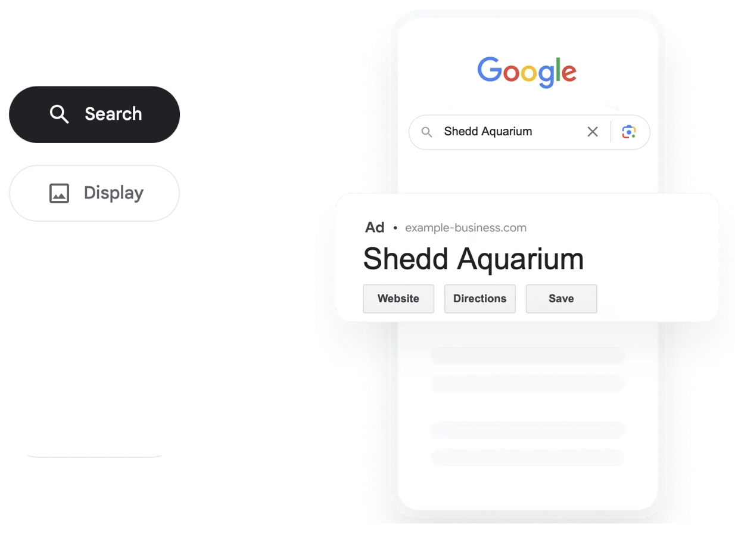
Online Ads
Google Search & Display
Programmatic
Social Media Ads (Facebook, Instagram)
Video Ads (Youtube)
Notes:
Lauren
This part you explain:
Google Search ads
keyword-based search
example: “Chicago activities”
Banner ads on websites with Chicago activities (e.g., choosechicago.com)

Slide 28
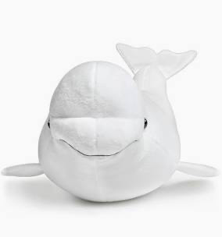
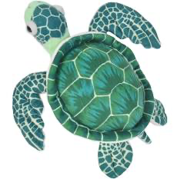
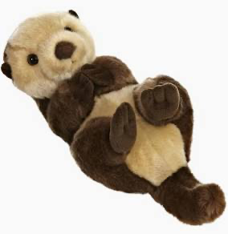
Branded Content
Sponsor an animal at Shedd
“Take Dora home and you will help rescue aquatic life.”
Notes:
*enhances brand image*
Event: series of talks hosted at Shedd with marine biologists or conservationists
people from National Marine Sanctuary Foundation

Slide 29

Beach Cleanup Sponsored by Shedd
Beach Cleanup – Alliance for the Great Lakes
  2022 AGL collected 31,188 pounds of litter
Those involved get free admission passes for the next weekend at Shedd
Lunch provided by Shedd
  Featuring Q & A with marine biologists or conservationists
  Mock rescue activities: showing families how to help a turtle caught in plastic
The Outcome
Community involvement
Conservation reputation
Assists families with a fun day for kids
Notes:
Lauren

Slide 30
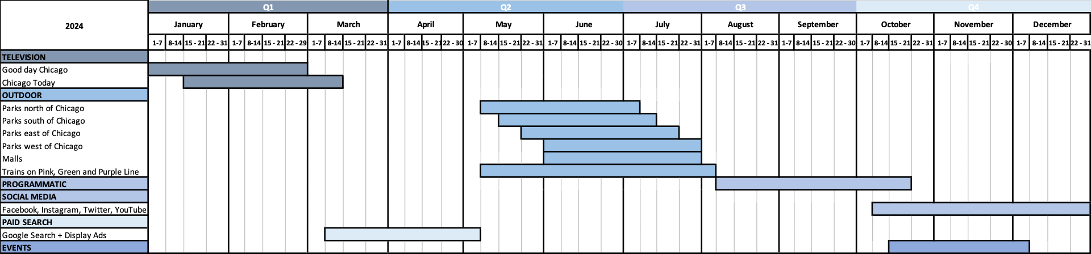
Media Scheduling
Notes:
Open holidays:
New Year’s Day (Jan. 1)
Memorial Day (last Monday of May)
Fourth of July (Independence Day)
Labor Day (First monday in Sept)
H
experiences that might drive higher traffic: https://www.sheddaquarium.org/experiences/touch-experiences

Slide 31



THANK YOU!

